Slide 1
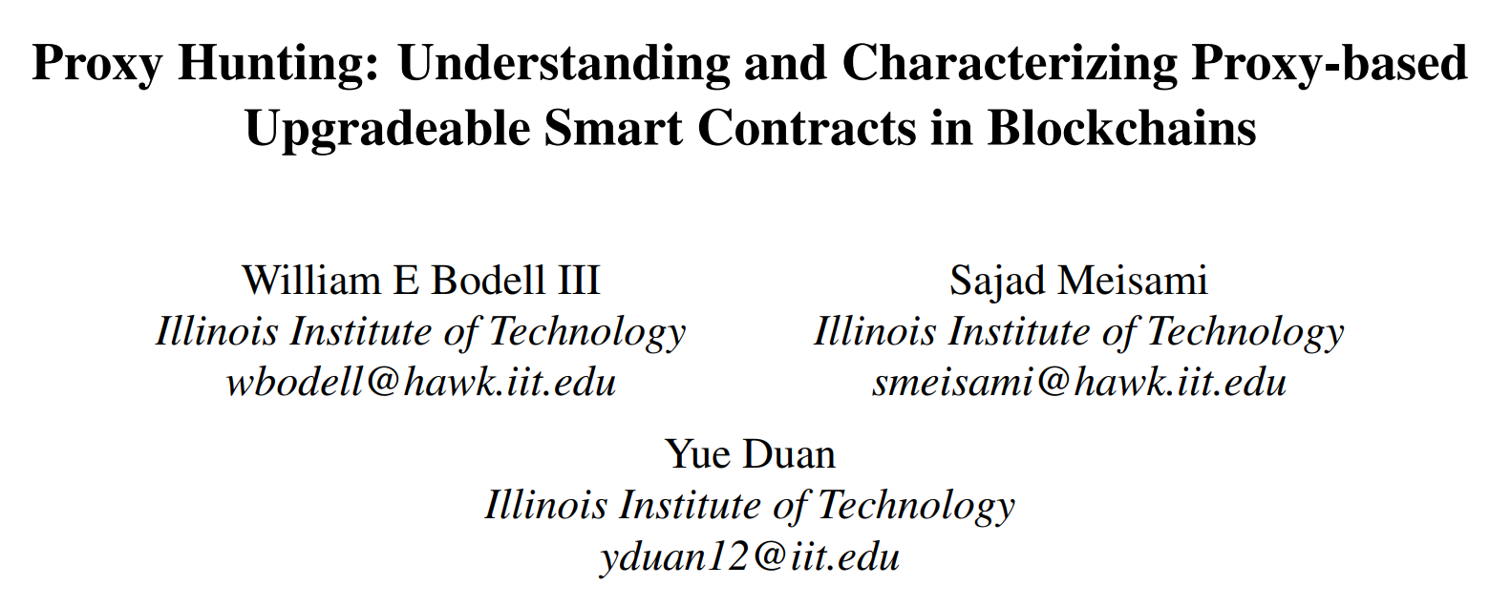
USENIX Security 2023

Slide 2
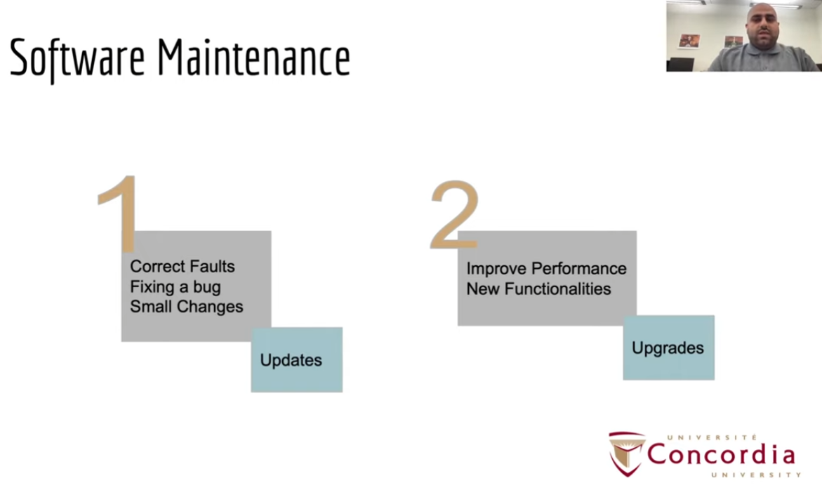

Slide 3
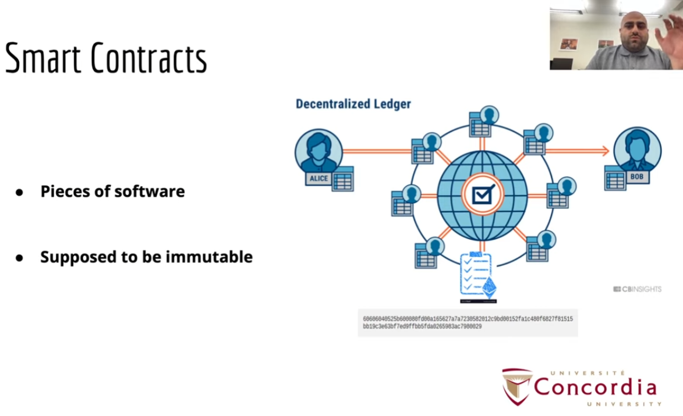

Slide 4
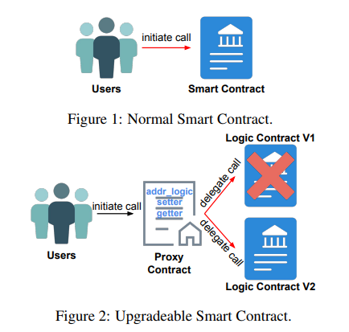
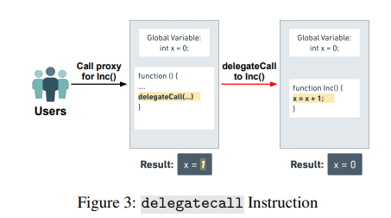
Background

Slide 5
Research Questions
1. Popularity and Value Over Time
What is the popularity of upgradeable proxy contracts?
How much total value is held by upgradeable proxies?
How have these changed over time?
2. USC Behaviors and Design Patterns
How can we characterize the uniqueness of USCs in the real world?
How are USCs implemented?
What are the unique behaviors and design patterns?
3. Security Risks
What are the security and safety issues associated with USCs?
What is the possible impact of each issue?

Slide 6

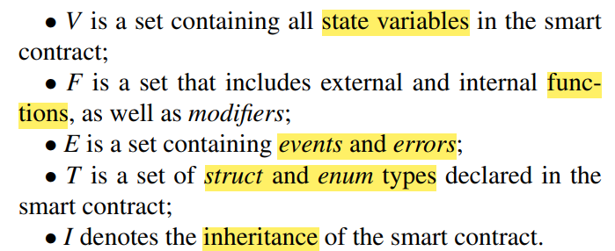
USC Taxonomy

Slide 7
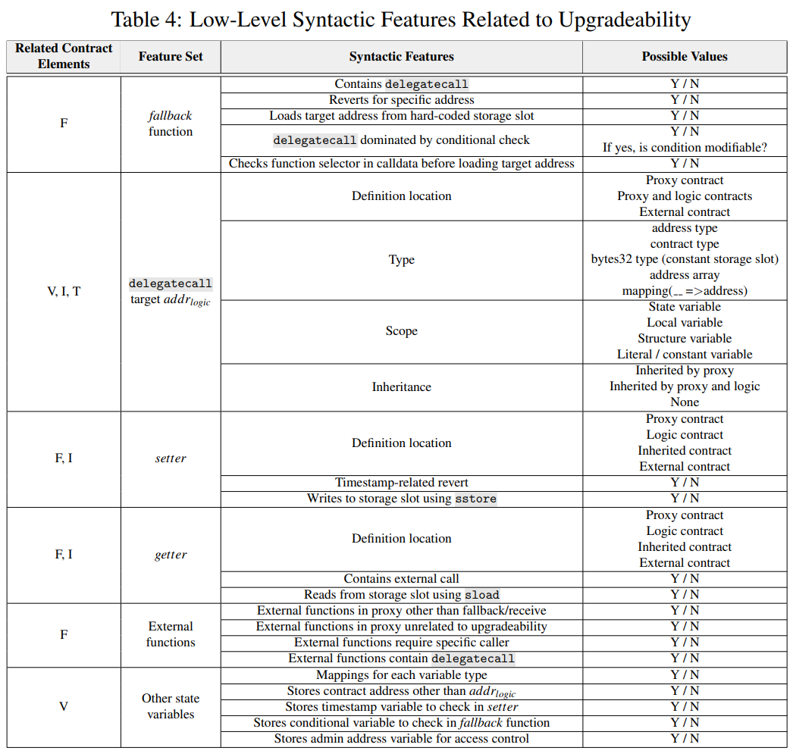

Slide 8
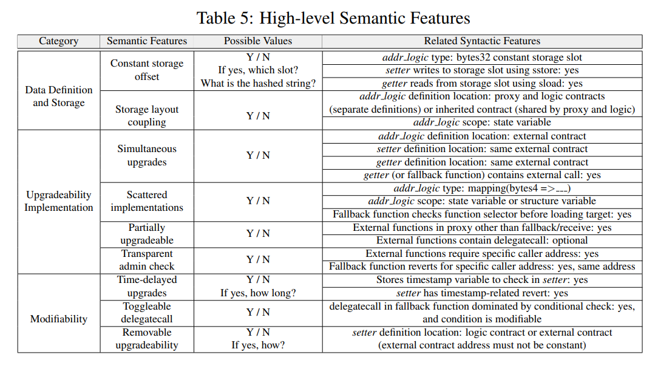
USC Taxonomy

Slide 9
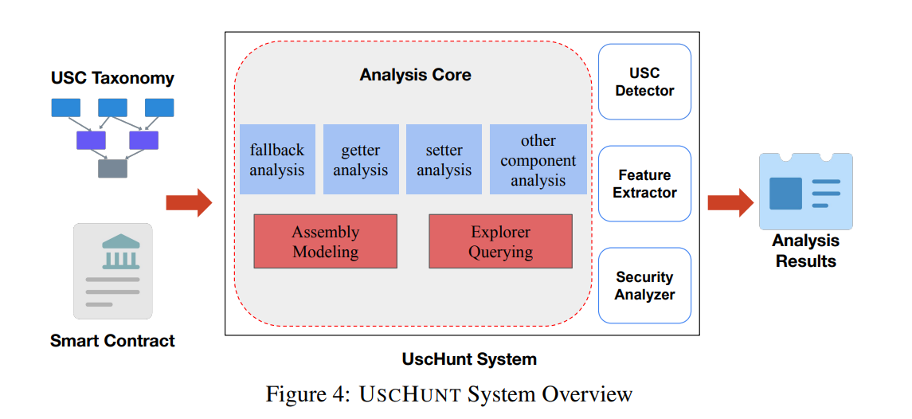
USCHUNT

Slide 10
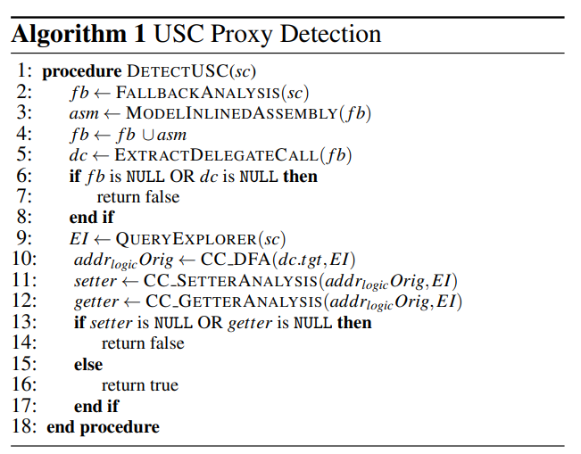
USCHUNT
Analysis Core:
fallback, setter, getter, other component
inter-procedural backward data-flow analysis
USC Proxy Dectection:
cross-contract interprocedural control flow graph (XCFG) , data-flow analysis
Behavioral & Security Analyses:
Control- and data-flow analysis
Taint tracking

Slide 11
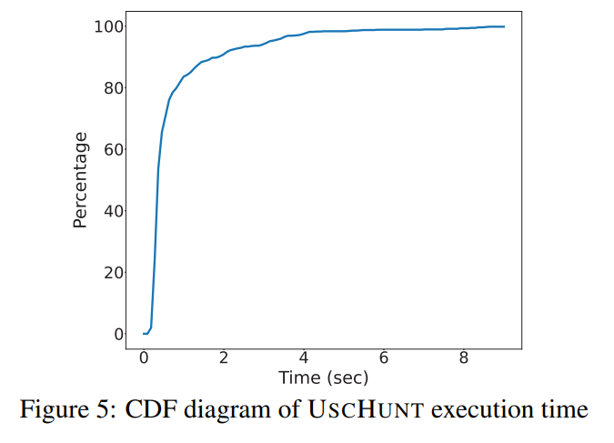
Evaluation of USCHUNT
Ground truth dataset
969 Slither detected as Proxy from Ethereum mainnet
+ 25 others (4 FN)
Manual investigation:
825 USCs
169 non-USC
Effectiveness
No FP
Misses only 13/825, FNR=1.3%
Efficiency
0.76s average; 83.6% < 1s

Slide 12
Study Methodology
1. Popularity and Value Over Time
popularity, total value, changed over time
Extract USCs, collect deploy and total value
Limitations: rely on source code; FN
2. USC Behaviors and Design Patterns
characterize , how implemented, unique behaviors and design patterns
Distill higher-level design pattern by combing multiple extracted features
Limitations: developed from samples, may not be exhaustive
3. Security Risks
security and safety issues , impact
Run security analyzer in USCHUNT
Limitations: compilation errors; some issues rarely found

Slide 13
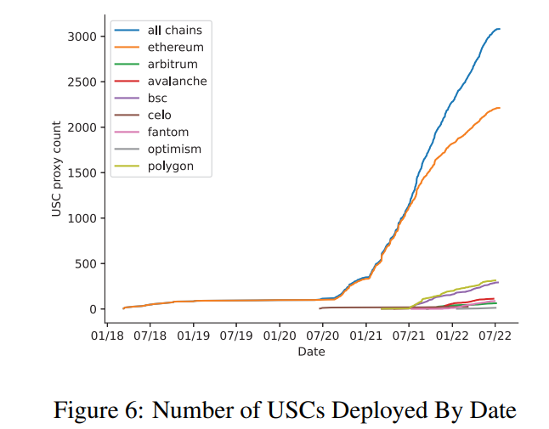
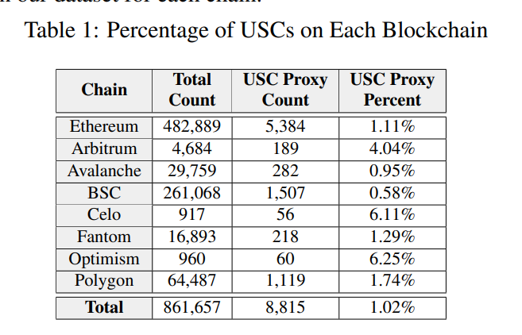
Study Findings: 1. Importance

Slide 14
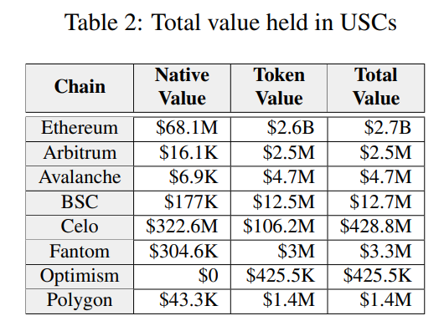
Study Findings: 1. Importance

Slide 15
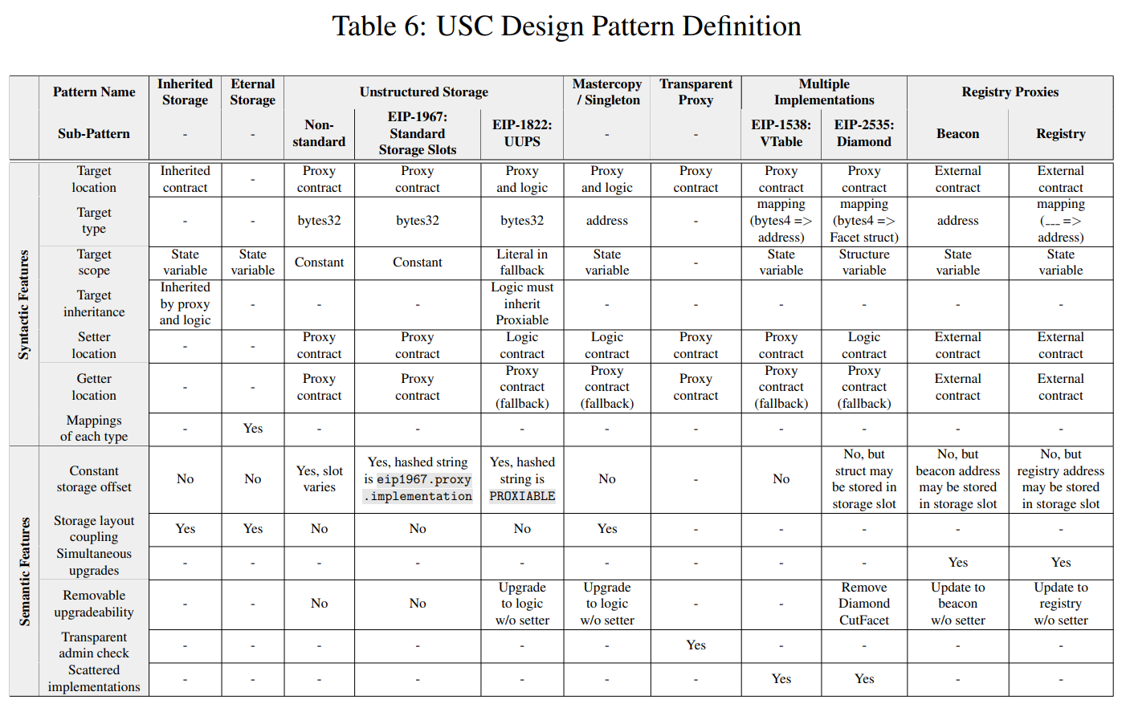
Study Findings: 2. Patterns and Behaviors

Slide 16
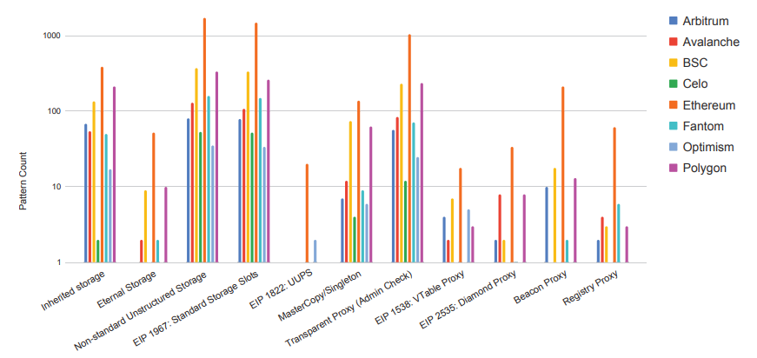
Study Findings: 2. Patterns and Behaviors

Slide 17
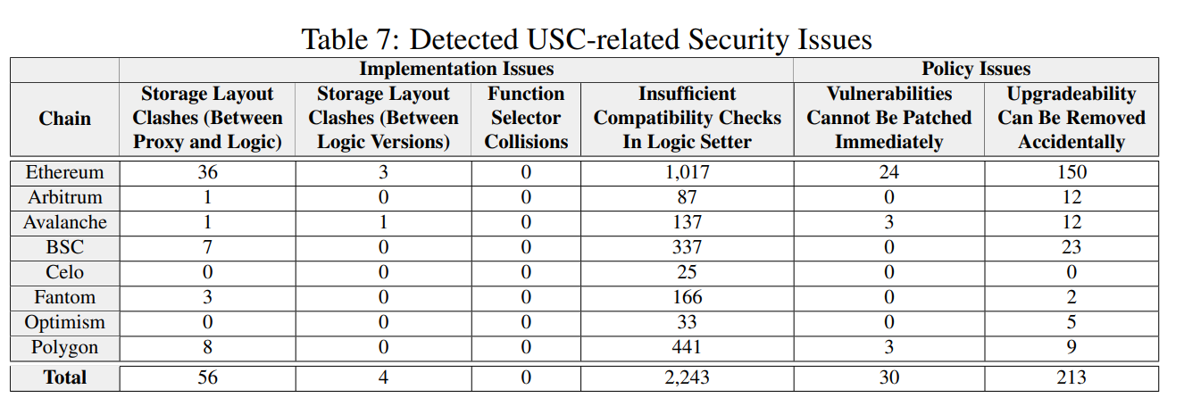
Study Findings: 3. Security and Safety Issues

Slide 18
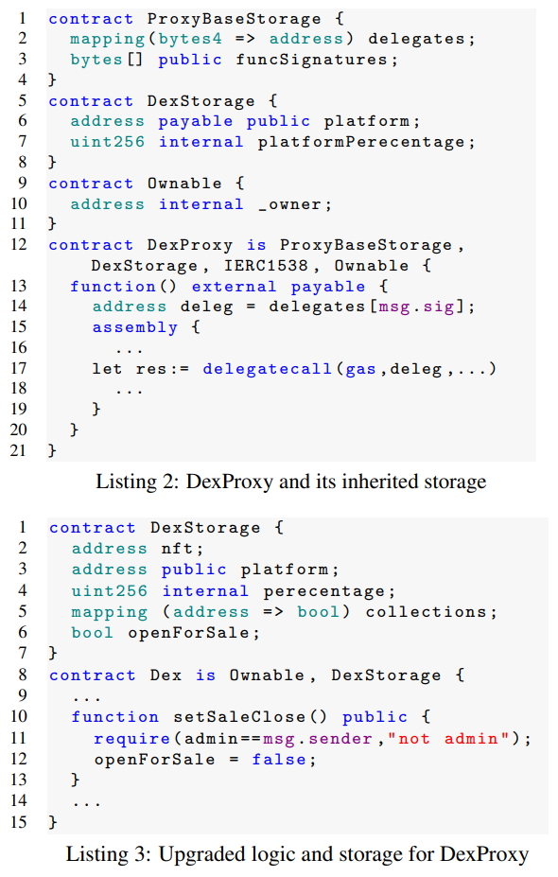
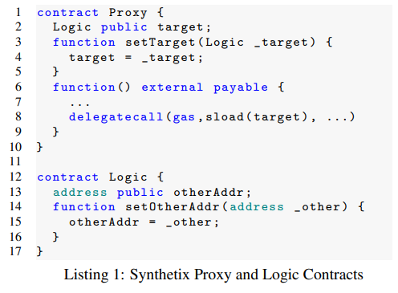

Slide 19
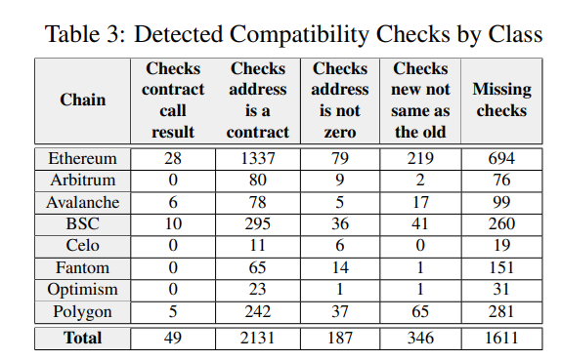
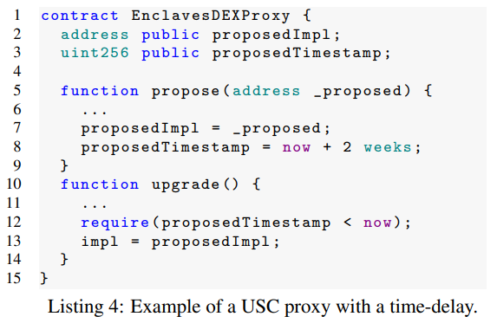

Slide 20
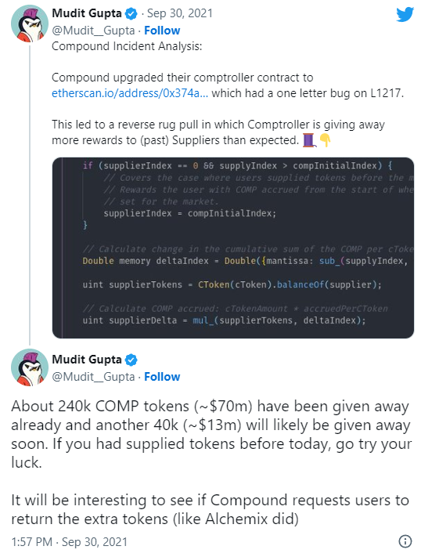
Future directions
Cross-contract analysis with multiple logic contracts
Closed-source contracts / different compiler
Differential fuzzing between multiple logic versions
Compound token distribution bug

Slide 21
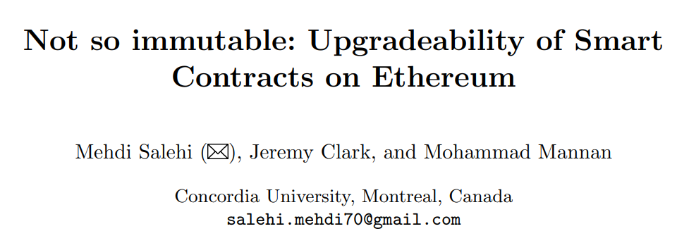
6th Workshop on Trusted Smart Contracts (WSTC22)

Slide 22
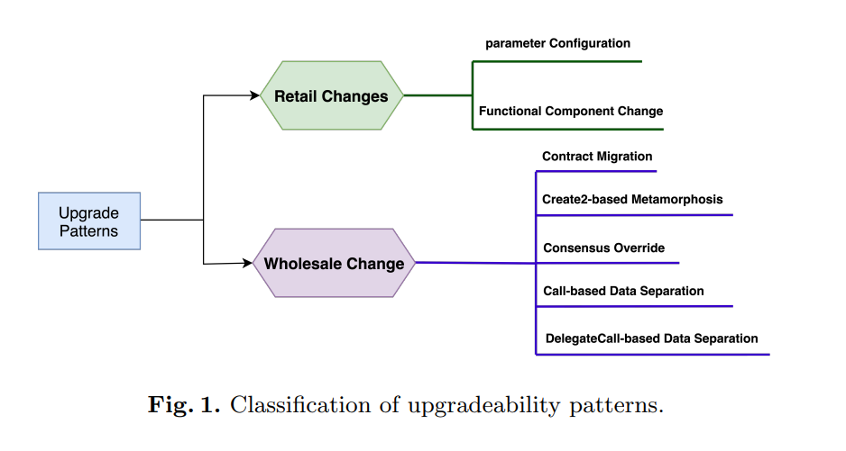
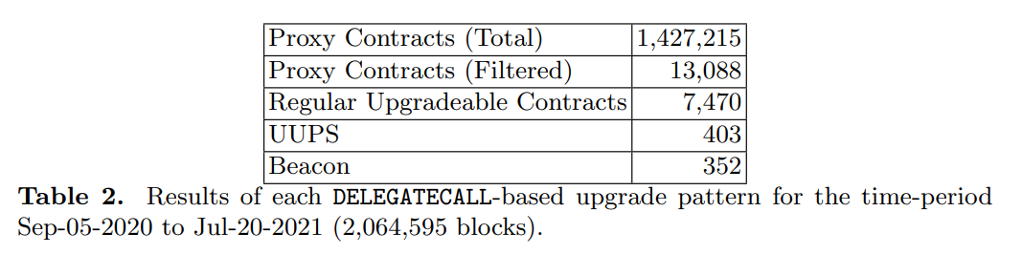
How?!
6 upgradability patterns
Measurement framework
8225/1.4m is proxy
Who is responsible?
50% EOA
14% multi-sig

Slide 23
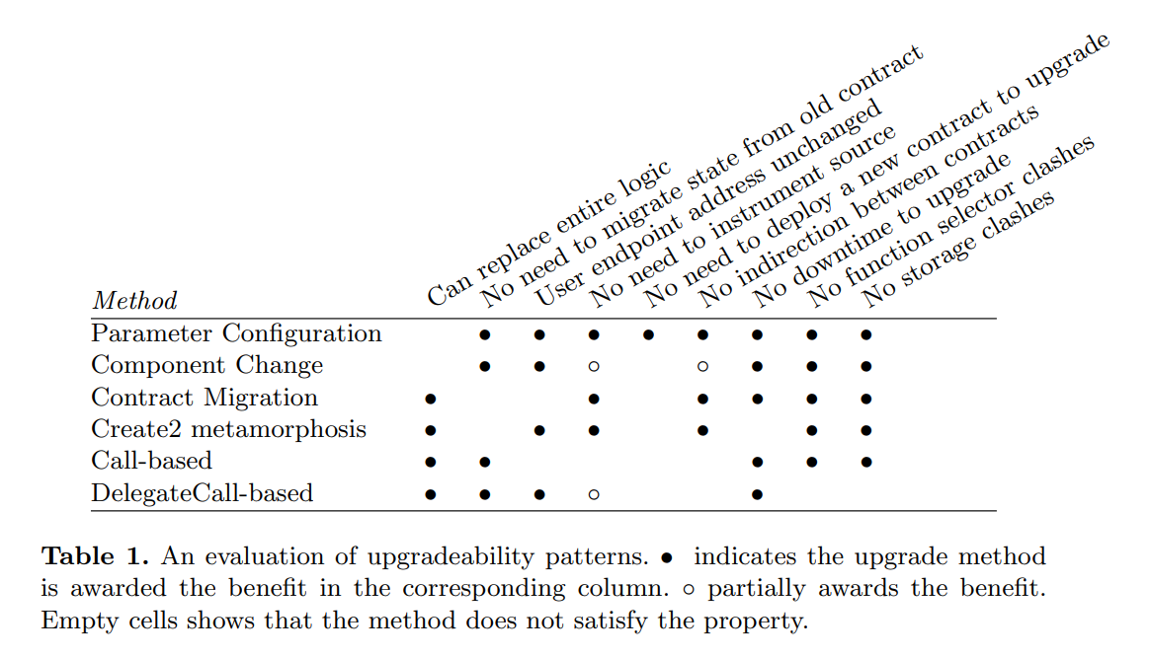

Slide 24
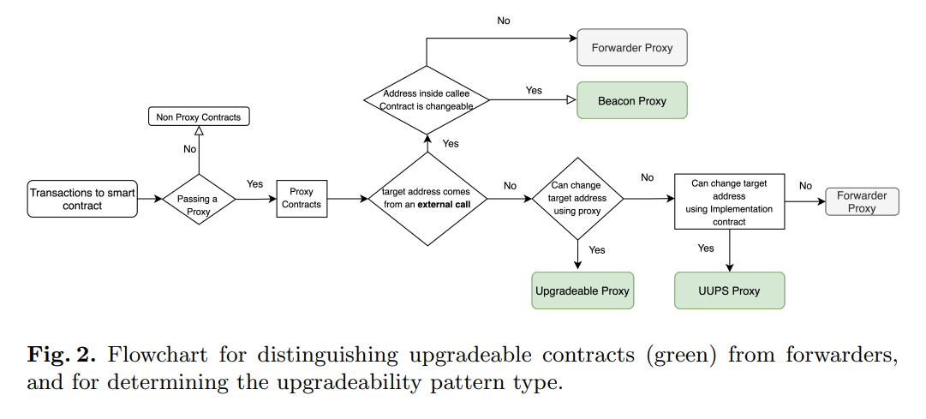

Slide 25
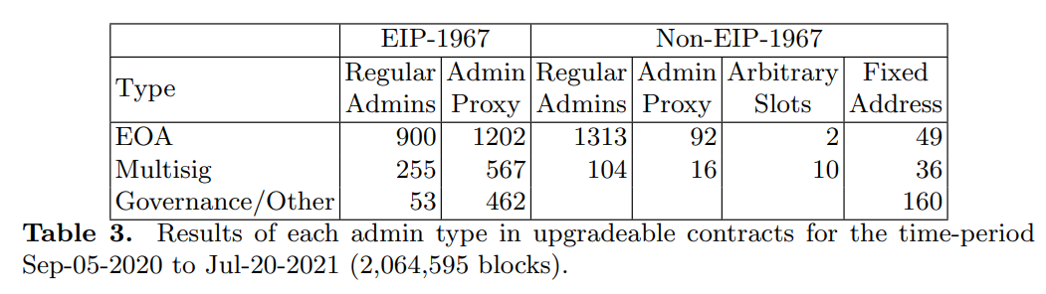

Slide 26
Comparison
Rely on dynamic transaction traces:
Not working if not deployed / has few transactions
Who has admin rights to perform an upgrade?
vs. 3 research questions, fine-grained view of real-world USCs
Different ways to avoid function selector clashes, including uncommon non-proxy ways
vs. focusing on delegatecall-based patterns, build taxonomy systematically

